Slide 1

Project Title
Glowkart
Team No: 14
TEAM MEMBERS
Name | Roll No.
HARSH BANSAL | 2210990376
HIYA KASHYAP | 2210990415
ISHPREET KAUR | 2210990424
JAI CHOPRA | 2210990427
22CS016

Slide 2

TABLE OF CONTENT
Introduction
Objective
Market Competitor
Technique Used
Features
What’s Next?
22CS016

Slide 3

INTRODUCTION
Introducing Glowkart, where science meets nature to bring out the best in your skin. We believe in the power of gentle, effective care that enhances your natural beauty without compromise. Whether you're looking to rejuvenate, protect, or simply pamper your skin, Glowkart offers a range of products tailored to meet your unique needs. Experience the transformative power of skincare that truly cares for you.
22CS016

Slide 4
OBJECTIVE
Our objective is to provide customers with a comprehensive skincare range that addresses various skin concerns while promoting healthy, radiant skin.
By prioritising customer education and satisfaction, we strive to empower individuals to make informed choices and embrace skincare routines
We are a team of skincare enthusiasts making skincare accessible to everyone.
Our project brings together creating an informative and user-friendly e-commerce skincare website.

Slide 5





MARKET COMPETITOR
We are an e-commerce website based only on skincare unlike our competitors which also include clothing, beauty, etc.
We also have a quiz based on which user can get a personalized skincare routine catering to every individual needs.
22CS016

Slide 6




TECHNIQUES
CSS
HTML
React
JAVASCRIPT
NodeJS
ExpressJS
22CS016

Slide 7
PRODUCT FEATURES
Customisable Filters: Easily sort and filter products based on your specific skin type, concerns, and preferences, ensuring you find exactly what you need.
Targeted Solutions: Browse products that are specifically formulated to address your unique skincare needs, from acne and aging to hydration and brightening.
Expert Recommendations: Get personalised product suggestions tailored to your skincare goals, backed by expert knowledge and user reviews.
Comprehensive Information: Access detailed descriptions, ingredient lists, and usage tips to make informed decisions and choose the best products for your skin.
Real-Time Updates: Stay informed with the latest product launches and updates, ensuring you always have access to the newest and most effective skincare options.
22CS016

Slide 8



Discover our carefully curated selection of skincare essentials, handpicked to cater every skin type and concern. Each product is chosen for its quality, effectiveness, and ability to bring out your best skin

Slide 9
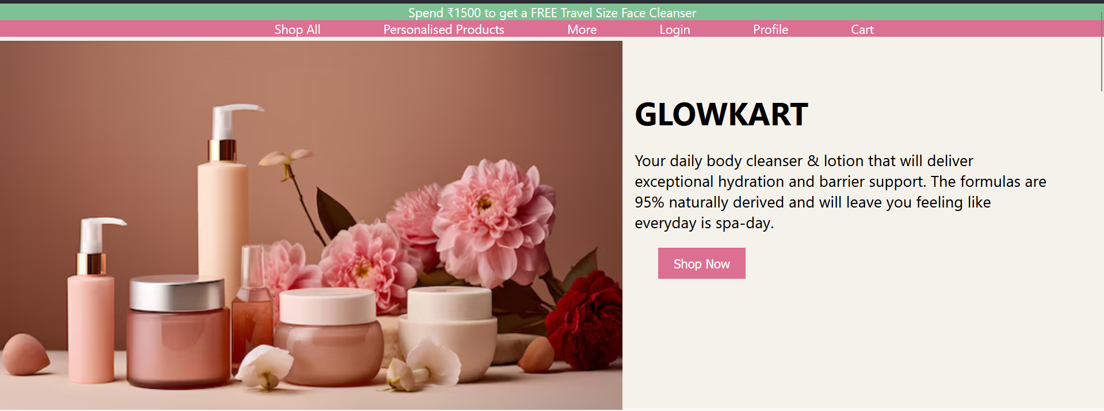
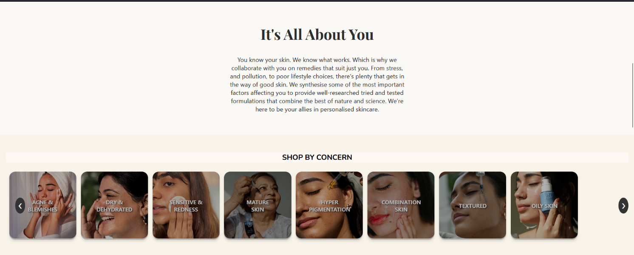
SCREENSHOTS

Slide 10
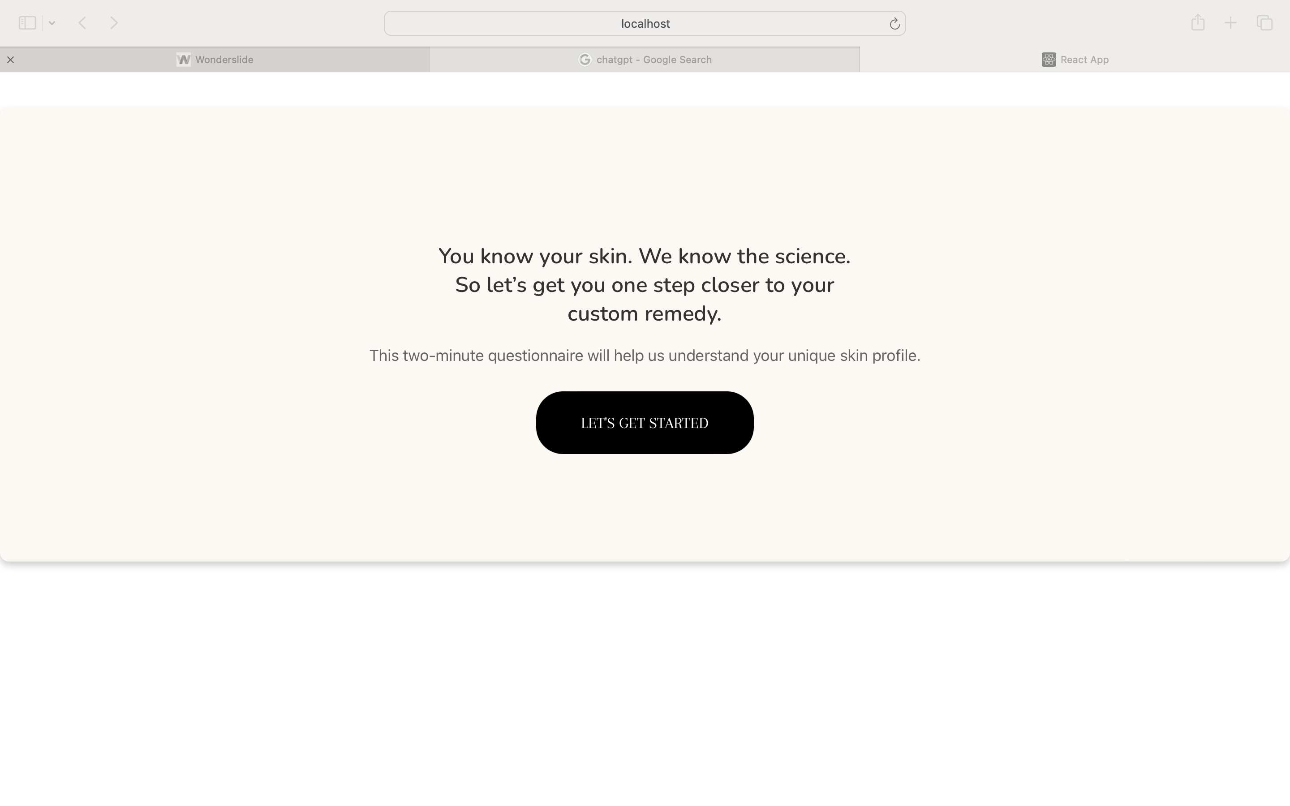
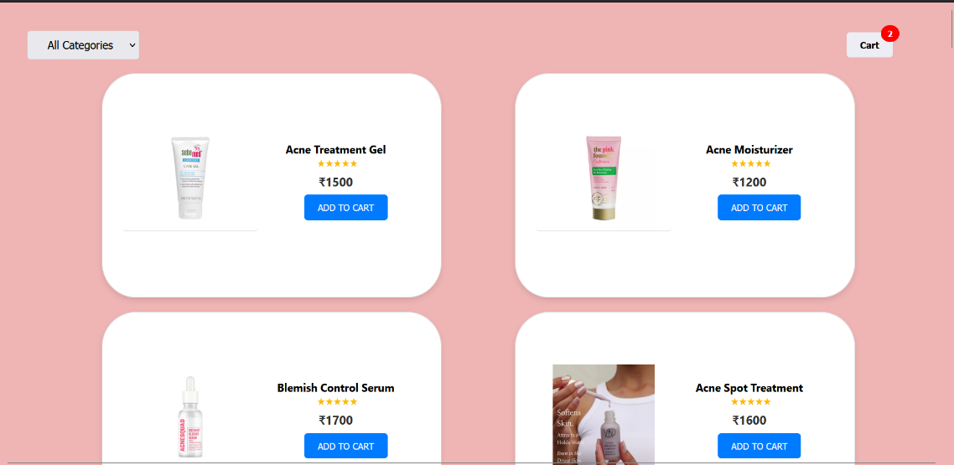
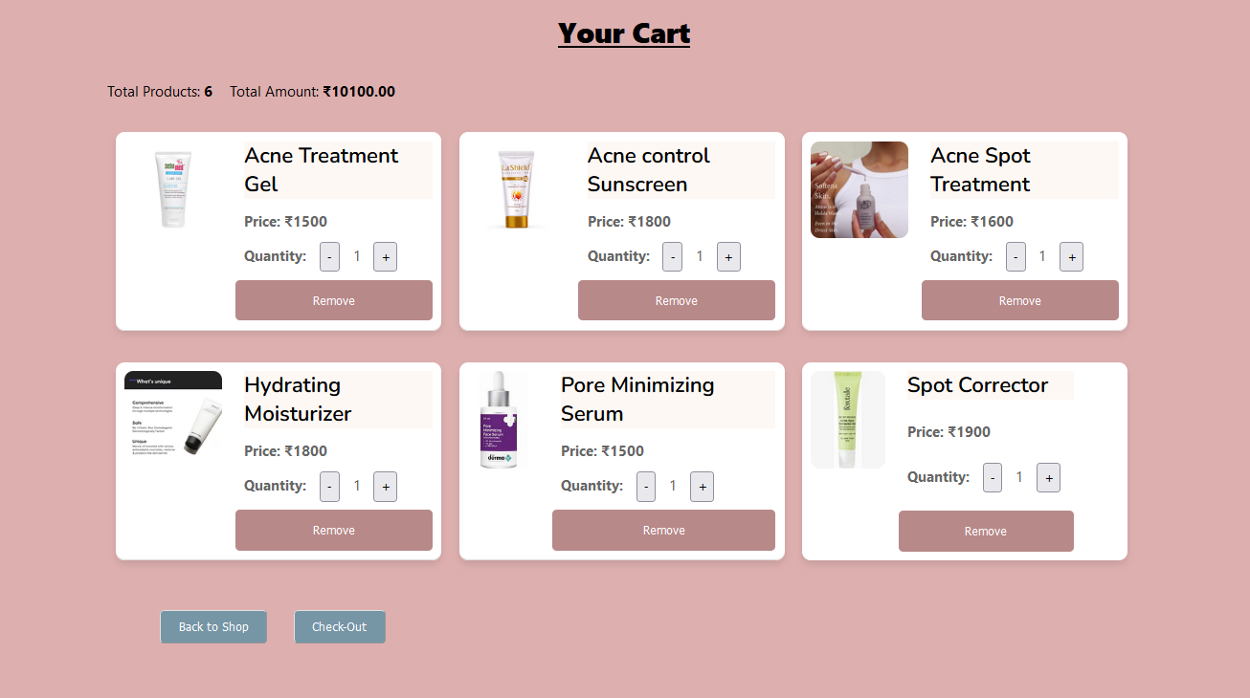
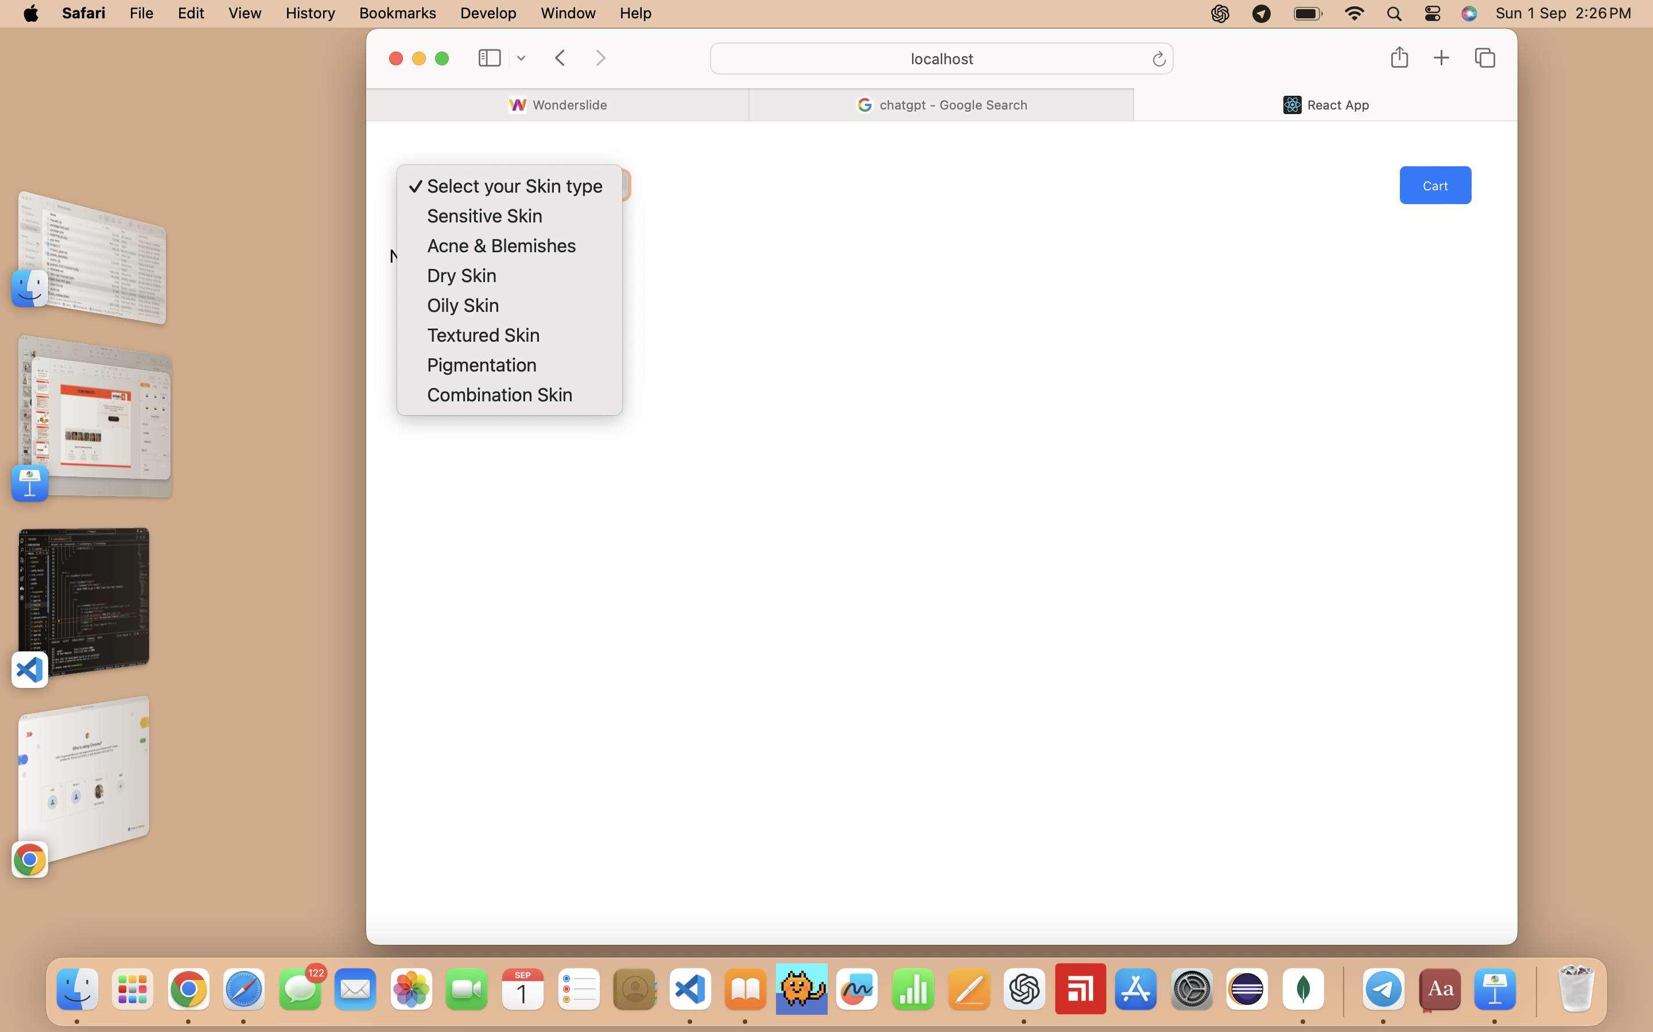
SCREENSHOTS

Slide 11
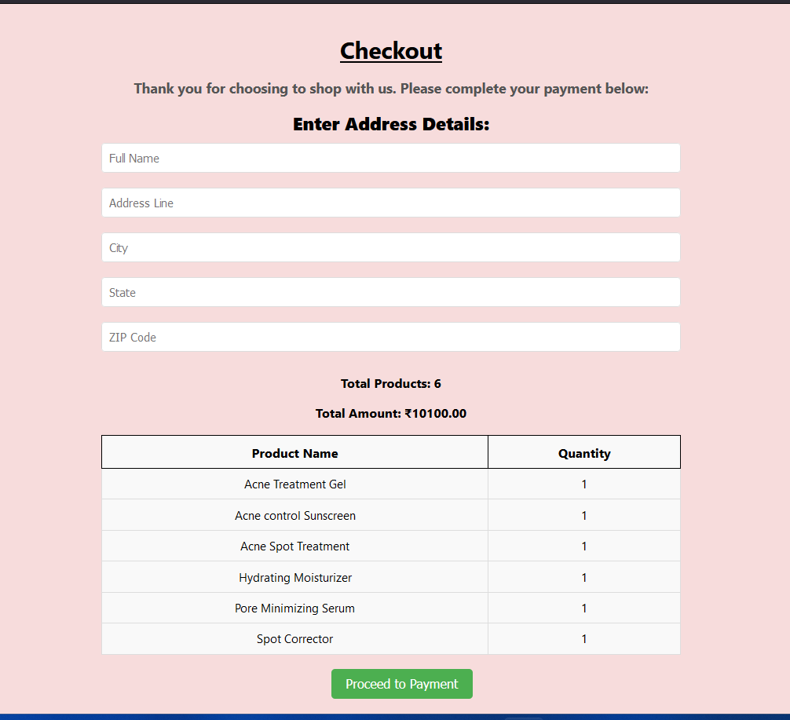
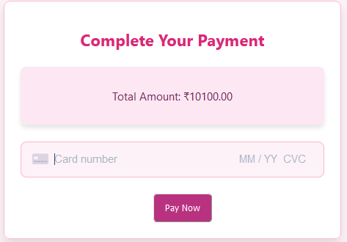
SCREENSHOTS

Slide 12
WHAT’S NEXT
Add admin panel
Real Time Communication
22CS016

Slide 13
REFERENCES
https://www.suhiandsego.com/?utm_source=google&utm_medium=cpc&utm_campaign=hvs_google_pmax_all-products_210723&utm_term=&utm_content=&utm_creative=&gad_source=1&gbraid=0AAAAAousM_s-J6E-MTlPl6BAk9niN7btb&gclid=EAIaIQobChMIsqSvlcvuhwMVwSuDAx3yUTuIEAAYAiAAEgLvGvD_BwE
https://ybpskin.com/?utm_source=google&utm_medium=cpc&utm_campaign=pmax_ma_sale&utm_content=General_MA&gad_source=1&gbraid=0AAAAApSmm8lJtCAlVV5woEWihS4GU9_7M&gclid=EAIaIQobChMIsqSvlcvuhwMVwSuDAx3yUTuIEAAYASAAEgJSrvD_BwE
22CS016

Slide 14


Thank you
Team,
GlowKart
22CS016

